Slide 1
CHURN MODELLING BANK
DATA ANALYSIS
BASMALA KHALED

Slide 2
DATASET OVERVIEW
CHURN MODELLING BANK
Source
contain
key
Feature
Target
Variable
•- SOURCE:
•- CONTAINS
•-KEY FEATURES:
•- TARGET VARIABLE
Churn_Modelling.csv
information on 10,000 bank customers
Columns: Customer ID, Surname, Geography, Gender, Credit Score, Age, Tenure, Balance, Num ofProducts, Has Credit Card, Is Active Member, Estimated Salary, Exited
•- Target variable: Exited (1 = Customer left, 0 = Stayed)

Slide 3
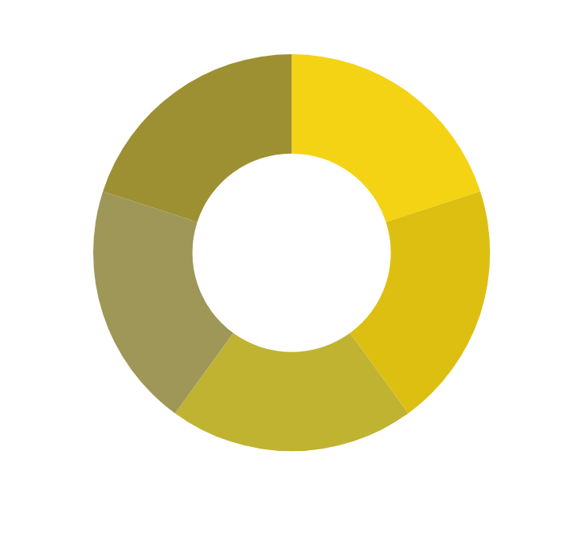
IMPORTING LIBRARIES
•- PANDAS:
FOR DATA MANIPULATION
•- NUMPY:
FOR NUMERICAL OPERATIONS
•- MATPLOTLIB& SEABORN:
FOR DATA VISUALIZATION

Slide 4
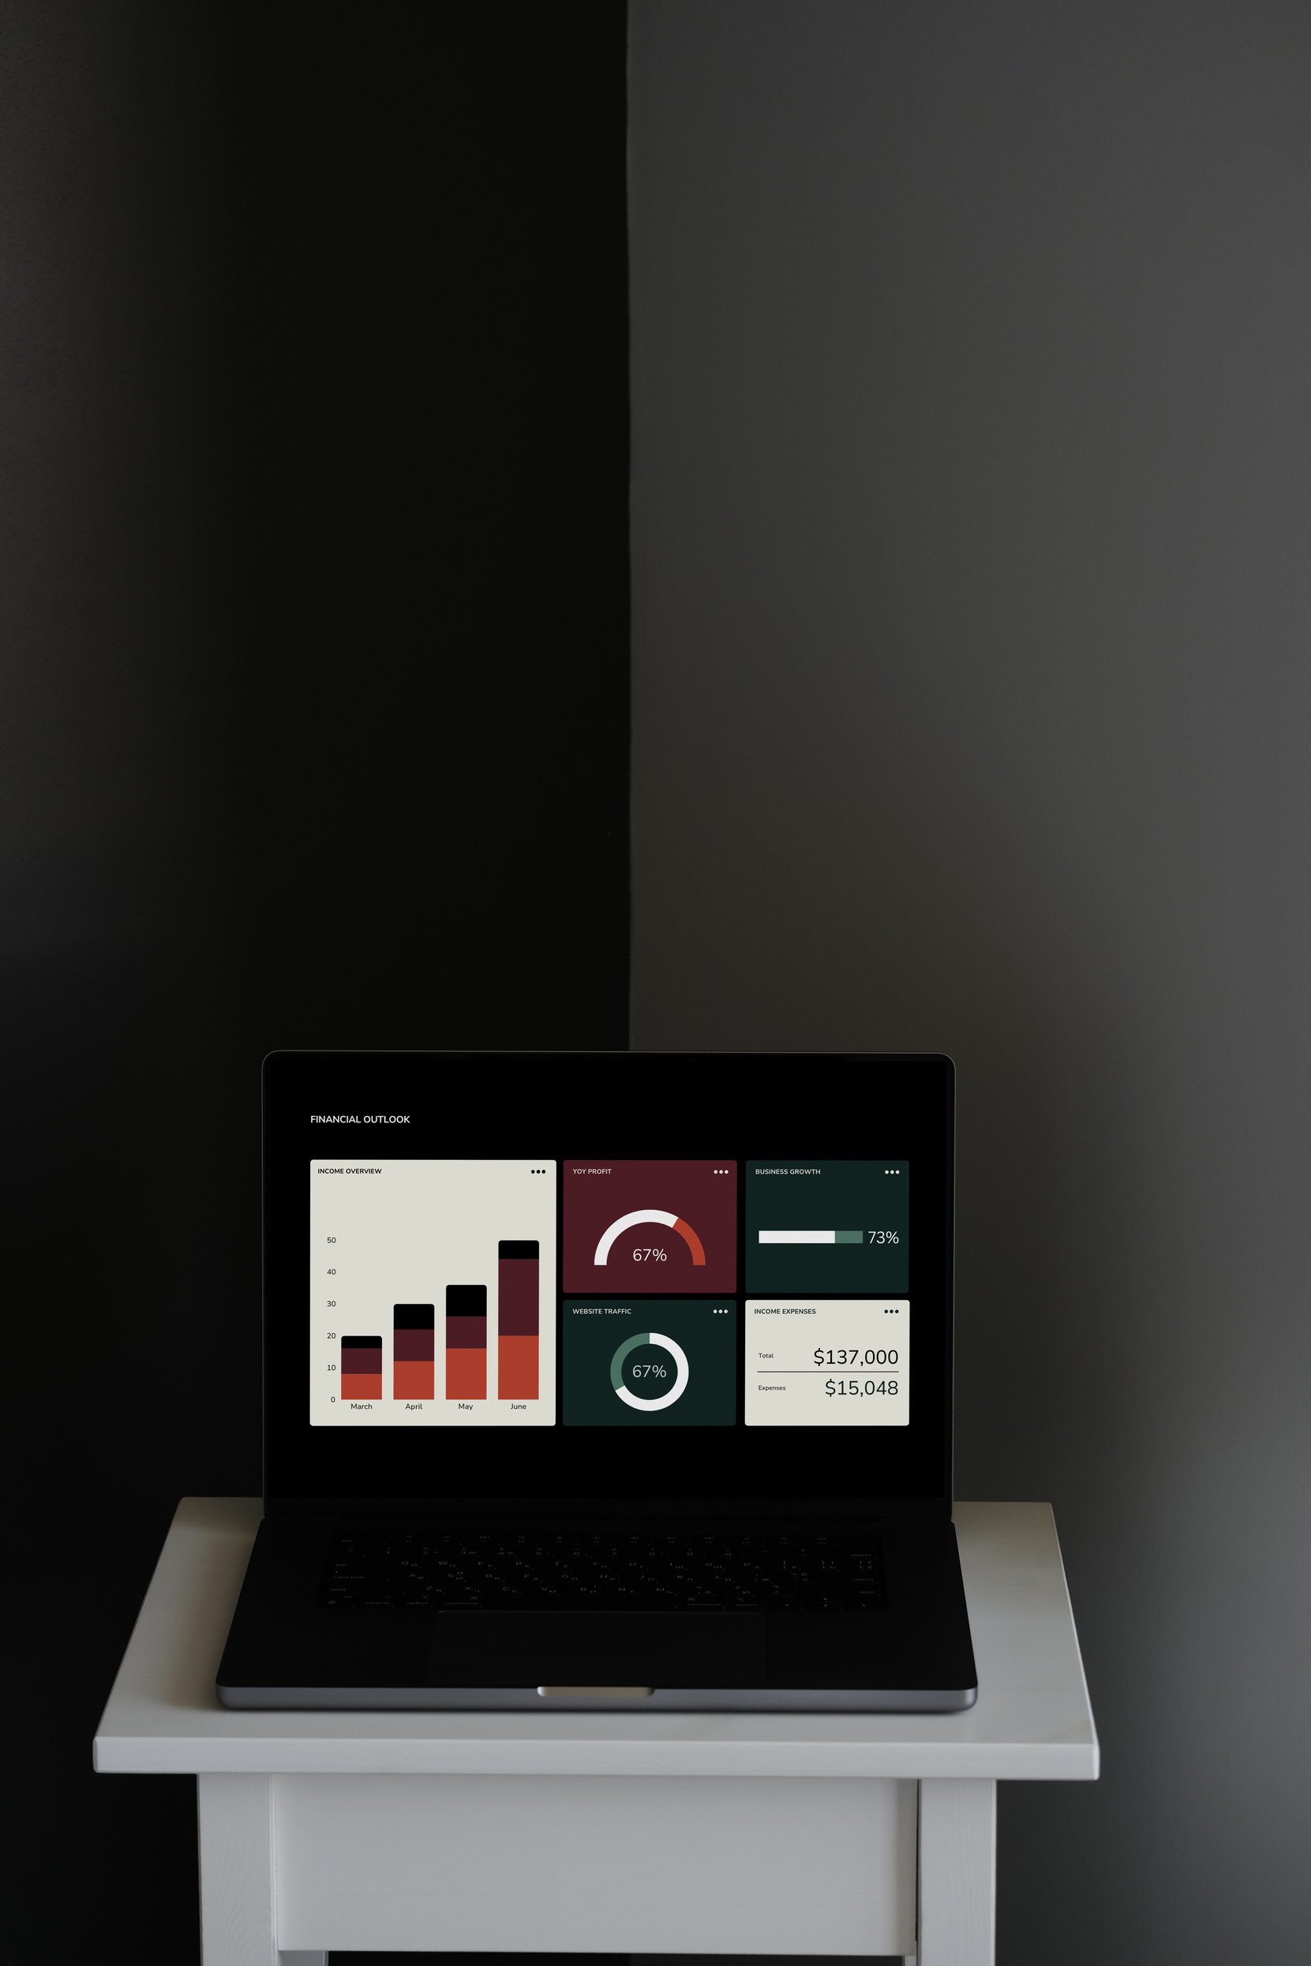
READING THE DATA
•USED:
•df = PD.READ_CSV('CHURN_MODELLING.CSV'
•INITIAL EXPLORATION WITH:
•DF.HEAD()
•DF.INFO()
DF.DESCRIBE()

Slide 5
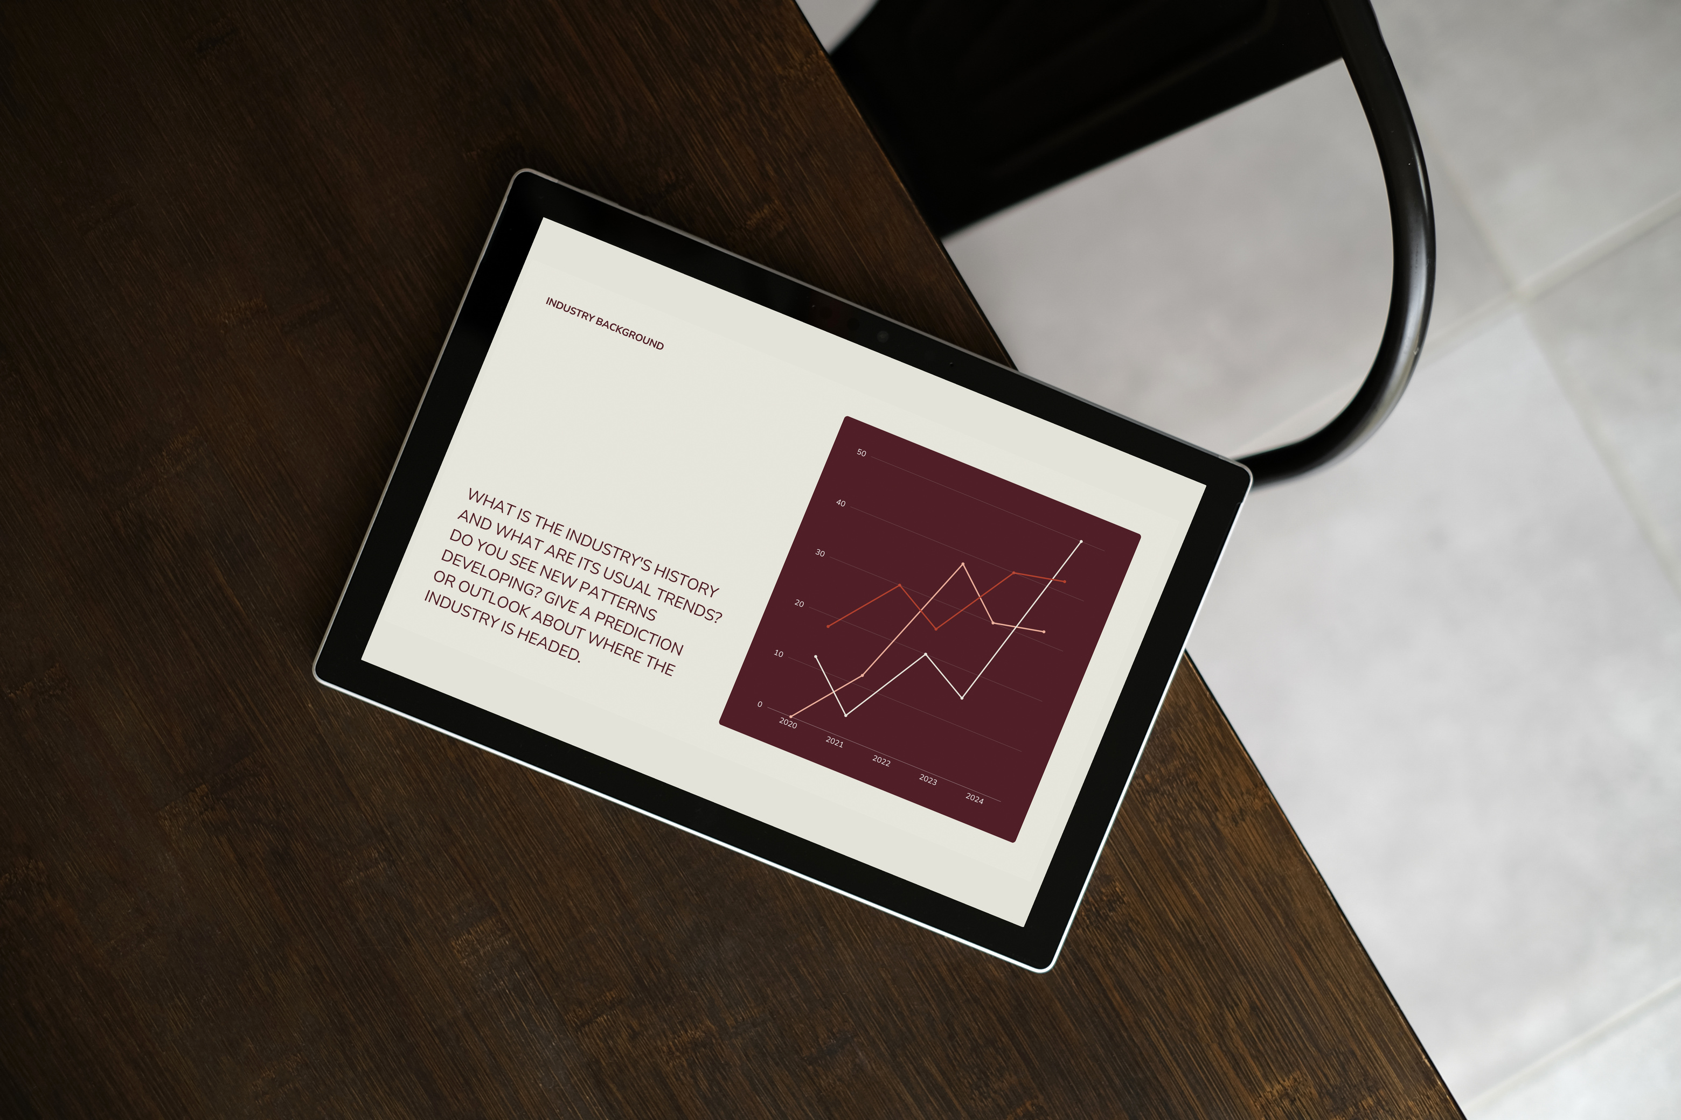
CHECKING MISSING DATA
•Checked for missing values using:
•df.isnull().sum()
RESULT
No major missing values were found in the dataset.

Slide 6
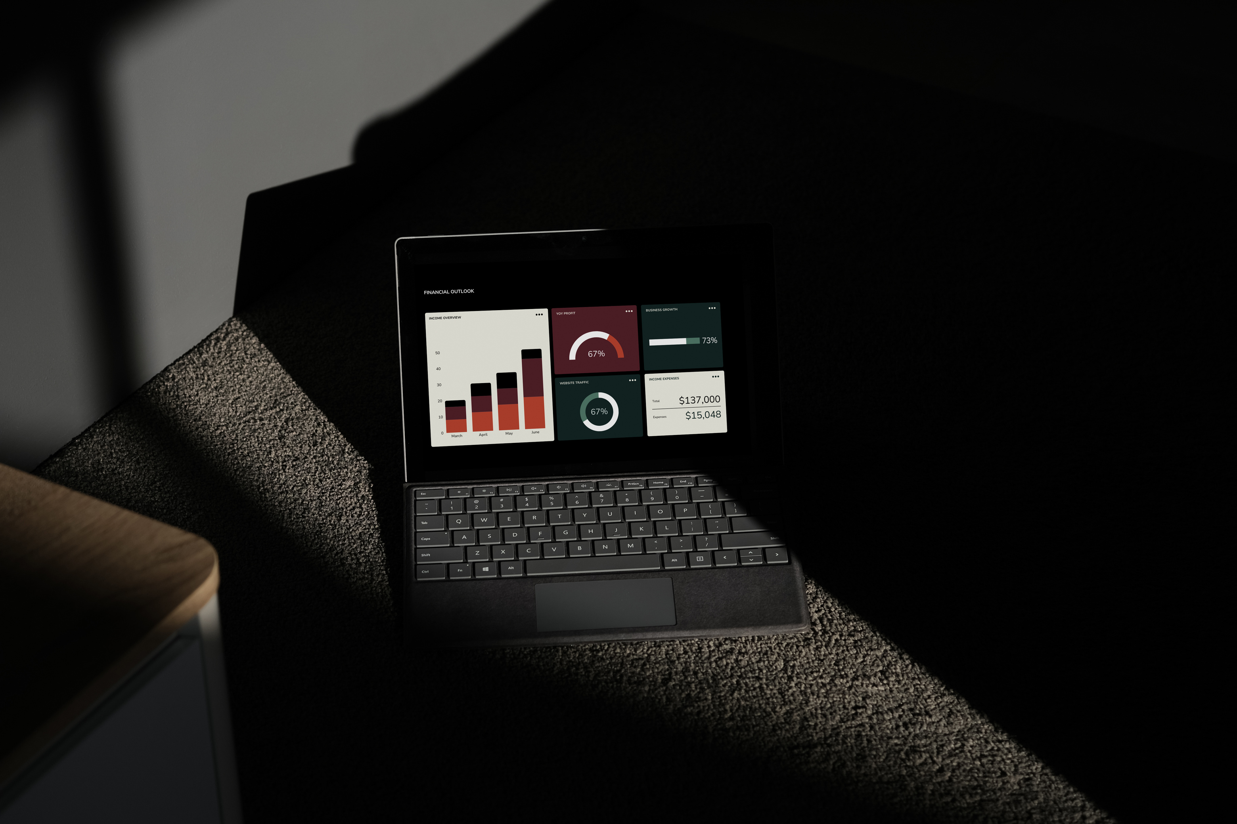
DATA CLEANING
•- Removed irrelevant columns: RowNumber, CustomerId, Surname
•- Standardized categorical fields
•- Ensured numerical data types were consistent

Slide 7
DATA VISUALIZATION
•Used matplotlib and seaborn to visualize:
•- Customer age distribution
•- Customer churn ratio:
Churned Customers: 20.4%
Retained Customers:79.6%
•- Correlation between variables
•- Relationship between Age and Credit Score

Slide 8
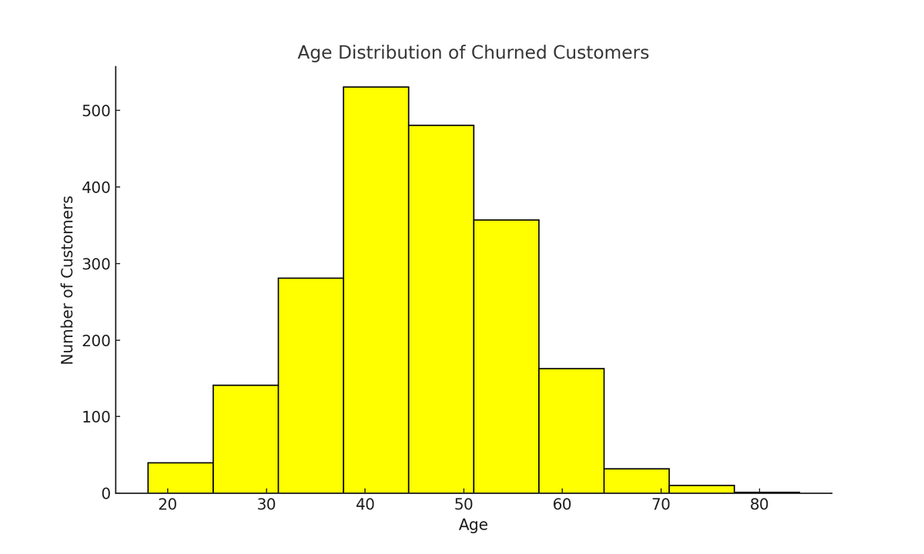
VISUALIZATION: AGE DISTRIBUTION
A hISTOGRAM WAS CREATED TO VISUALIZE HOW CUSTOMER AGES ARE DISTRIBUTED AMONG THOSE WHO CHURNED.
THE CHART REVEALS THAT CHURN PEAKS WITHIN THE 35 TO 50 AGE RANGE, INDICATING A VULNERABLE SEGMENT THAT REQUIRES FOCUSED RETENTION STRATEGIES.

Slide 9
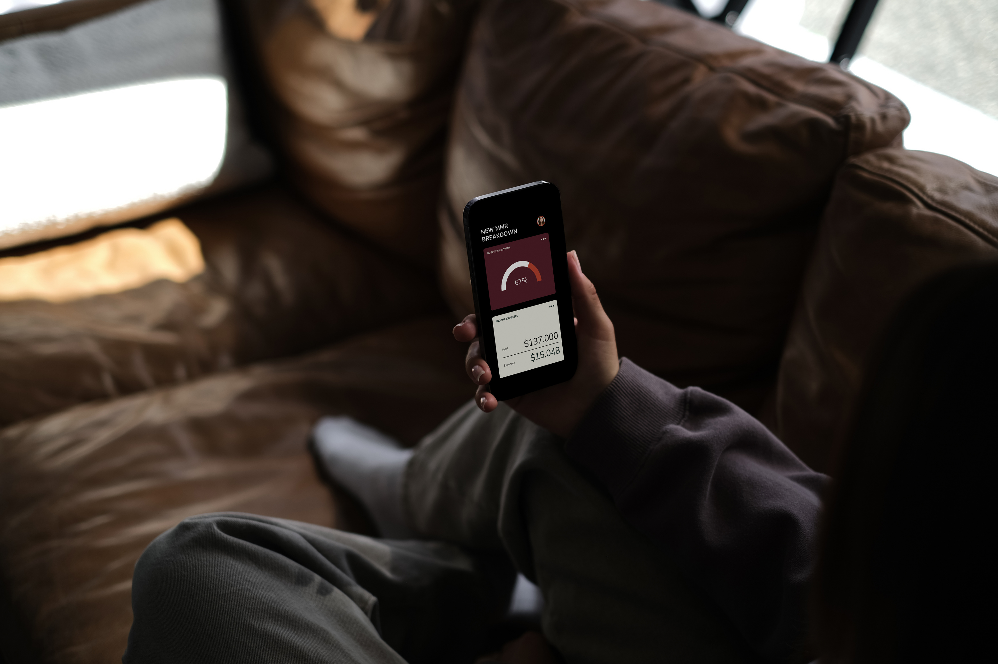
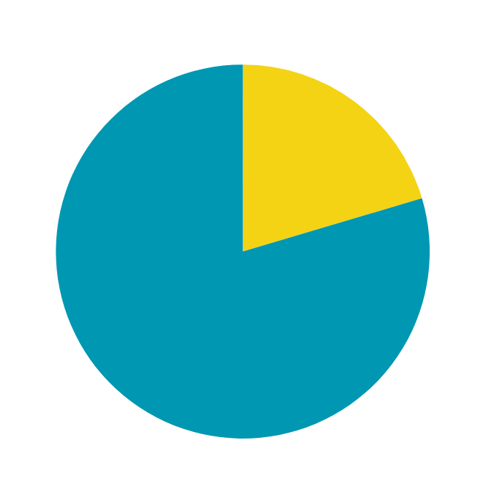
VISUALIZATION: CHURN RATIO
Pie chart was used to show percentage of customers who exited vs. stayed

Slide 10
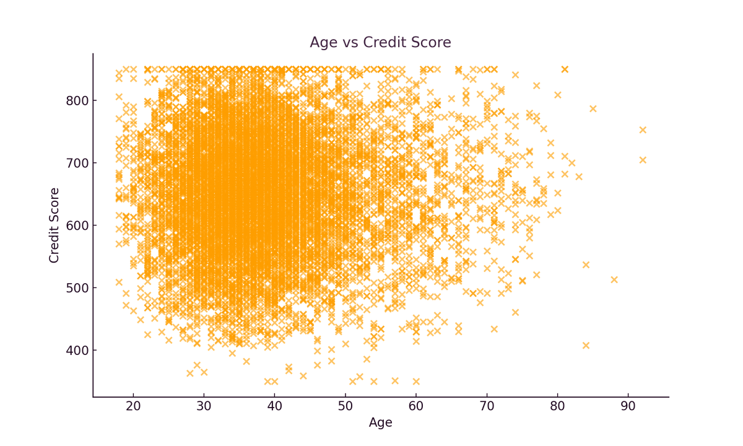
VISUALIZATION: AGE VS CREDIT SCORE
•Scatter plot visualizes the relationship between Age and Credit Score.

Slide 11
SUMMARY & NEXT STEPS
•- Dataset was clean and ready for modeling
•- Visualizations gave insight into key patterns
•- Next step: Encode categorical data and build ML models (not done yet)

Slide 12
THANK YOU
FOR YOUR ATTENTION

